Slide 1
Comparative and superlative Adjectives
Rozanah Katrina Herda, M.Pd

Slide 2
COMPARATIVE ADJECTIVES

Slide 3
As you know, words are made of syllables.
  Fat fat = one syllable
  Handsome hand-some = two syllables
  Beautiful beau-ti-ful = three syllables
Remember!!!
To make the comparative of one syllable adjectives you only should add er.
  Short = shorter Old = older
Fill in the gaps. Use the comparative of the word in brackets.
    My house is ______ than yours (small)
    Sara is ______ than Tom (young)
    Teresa is ______ than John (old)

Slide 4
Remember!!!
The spelling sometimes changes. Look at the following comparatives.
2. Write sentences. Use comparatives.
  Karol/ thin/ Maria __________________________
  Rob /funny/ Sam __________________________
  My classroom/big/yours _____________________
  Mary/happy/ Johanna _______________________
Short adjectives with one vowel and one consonant | Big bigger Fat fatter Thin thinner
Adjectives that end in y | Funny funnier Heavy heavier

Slide 5
Adjectives which have two or more syllables always form the comparative with more.
dangerous = more dangerous
3. Complete the sentences. Use the comparative of the word in brackets.
  Chemistry is ________ than English (difficult)
  Brad Pitt is ________ than Marc Anthony (handsome)
  Frank is __________ than Susan (intelligent)
  Jennifer is ___________ than Angeline (beautiful)

Slide 6
The following adjectives have irregular comparative forms:
good = better
bad = worse
far = farther
4. Fill in the gaps. Use the comparative form of good, bad and far.
  Italian food is ______ than American food (good)
  His handwriting is ______ than Mabel’s (bad)
  My school is _______ from here than the park (far)

Slide 7
5. Click on the answer you think is correct.
A. Argentina is _____ than England.
    bigger
    more big
    biggest
B. Tomas is _____ than his brother.
    attractiver
    more attractive
    most attractive

Slide 8
SUPERLATIVE ADJECTIVES

Slide 9
Remember!!!
Superlative adjectives
Superlative adjectives are used to talk differences between three or more people, animals or things. The word the comes before the superlative adjective.

Slide 10
Remember!!!
  We form the superlative by adding –est to short adjectives.
  Fast = the fastest New = the newest
  6. Complete the sentences. Use the superlatives of the words in brackets!
  Mary is ______ of all the students (tall)
  Jimmy's story is _______ story I've ever heard. (long)
  My brother is ________ person in my family. (smart)

Slide 11
Remember!!!
The spelling sometimes changes. Look at the following superlatives.
7. Write sentences by using superlatives.
My dog/big/all the dogs in the neighborhood.
Mary/fat/in the school
John/happy boy/ in the world.
Short adjectives with one vowel and one consonant | Big biggest Fat fattest Thin thinnest
Adjectives that end in y | Funny funniest Heavy heaviest

Slide 12
Adjectives which have three or more syllables always form the superlative with the most.
Max's house in the mountains is the most peaceful in the world
8. Write sentences.
  English/is/interesting/subjects
  My mom/is beautiful/woman
  Leonardo/is/intelligent/person/I’ve known

Slide 13
The following adjectives have irregular superlative forms:
good = The best
bad = The worst
far = The farthest
9. Fill in the gaps. Use the correct superlative.
  Cyntya has _______ grades in the class (good)
  Teresa had _______ day ever (bad)
  The North Pole is ________ place in the world (far)

Slide 14
10. Click on the answer you think is correct
D. David is the _____ person I've ever met.
    more attractive
    most attractive
    attractiver
E. Mrs. Stella is _____ teacher we ever had.
    the better
    the good
    the best
F. Hong Kong is one of the _____ cities I've visited.
    most interesting
    Interesting
    interest

Slide 15
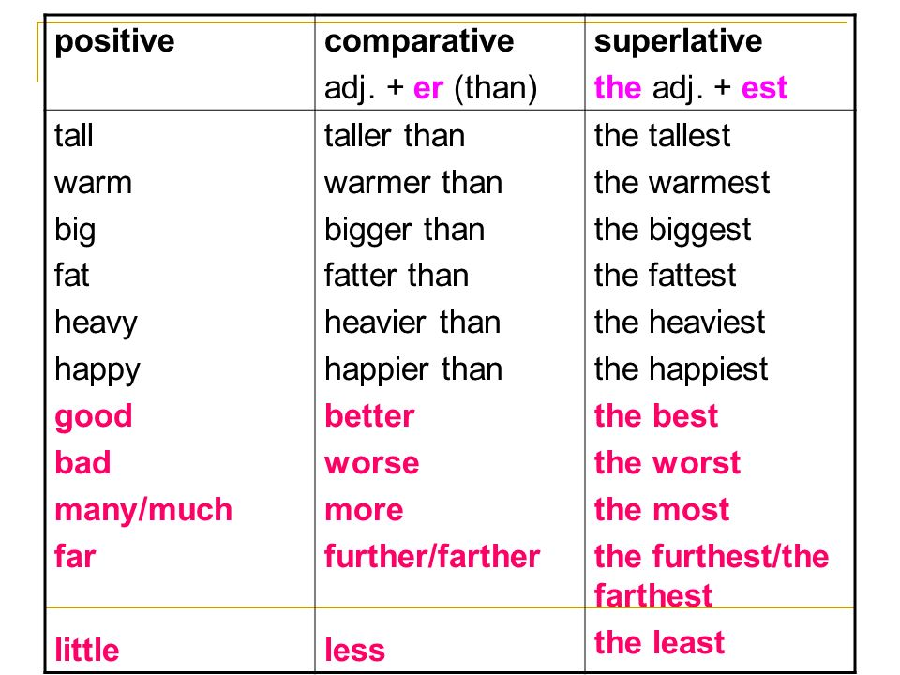

Slide 16
11. Complete the chart-
Adjective | Comparative | Superlative
Heavy | Heavier | heaviest
Good
Fat |  | The fattest
difficult
 | Funnier
 |  | The worst
Thin
 | Bigger
 |  | The most intelligent

Slide 17
12. Fill in the correct form of the words in brackets (comparative or superlative).
My house is (big) ____ than yours.
This flower is (beautiful) _______ than that one.
This is the (good) ______ book I have ever read.
Non-smokers usually live (long) _______ than smokers.
Which is the (dangerous) _______ animal in the world?
A holiday by the sea is (good) ______ than a holiday in the mountains.
It is strange but often a coke is (expensive) ________ than a beer.
Who is the (rich) _________ woman on earth?
The weather this summer is even (bad) _______ than last summer.
He was the (intelligent) _________ thief of all.

